Slide 1
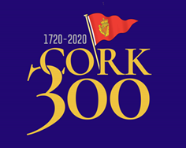
CORK 300 1720 – 2020 Water Club of Cork to Royal Cork Yacht Club
Festival of sail with broad participation over two plus weeks.
Celebrating the 300th anniversary of the worlds first yacht club,
Cork Harbor and the coast of Ireland.
Central event, July 12, 2020

Slide 2
CORK 300 1720 – 2020 Water Club of Cork to Royal Cork Yacht Club
Founded as the Water Club of the Harbor of Cork in 1720 for the purposes of sailing and camaraderie.
Earliest activities consisted of marshalled maneuvers on the water and extensive dining ashore.
The vessels of the fleet were brightly gilded and painted , sailed with colors flying, sounds of trumpets and drums. They were led by the Club’s Admiral on appointed dates and any overtaking was by prior approvals, only!
From the 1830’s, when the Club was granted a royal charter, sailing, cruising and racing inshore and offshore have featured in the activities of the Club.
Camaraderie and activities with yachts from visiting clubs has continued from the earliest days to the present.
– see RCYC website at https://www.cork300.com

Slide 3
Cork 300 Overall program Layout for Cruisers
Passages to Cork
Cruise Fest
Tues. to Sat
July 7-11
Fleet Review
Sunday July 12
Cruise in Company
Mon.- Wed.
July 13 - 22
Feeder cruise for European yacht clubs gather in Falmouth for cruise to Cork via Scillies July 4-7th
Special cruise from Howth to Cork celebrating their 125th anniversary being planned by HYC / ICC possibly with RCC and CCC , July 4-7th.
Celebrations of sailing and the sea. Variety of events planned.
Clubs and Classes form get-togethers at RCYC.
Cruise groups will be berthed / rafted together.
Water and shore activities.
President of Ireland takes salute from old RCYC building in Cobh.
Fleet, dressed, parade past for fleet review lead by Club admiral under 1720 orders!
Party on original grounds on Haulbowline island dock basin across passage in front of Cobh.
Cruise to West Cork and Kerry, numerous anchorages on extensive indented coastline.
Centered around four gatherings:
Kinsale Mon, 7/13
Schull Thurs 7/16
Bantry Sun. 7/19
Dingle Wed. 7/22
Cork Race Week Extensive week of racing in the harbor and off the coast for a wide variety of classes

Slide 4
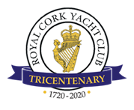
CCA – Cork 300 Festival of Sail July 2020
Opportunity:
Royal Cork YC invitation to participate in its tri-centenary celebrations: 1720 – 2020
Offering mix of sailing events and range of associated maritime interests.
International connections and camaraderie with Royal Cork and “sister” cruising clubs – ICC, RCC, CCC, OCC.
Cruising areas extended through West Cork to include Kerry Coastline.
Program outline
RCYC developing broad umbrella of activities within which multiple interests may participate as “sub-groups”
RCYC Cruise Committee will set out framework of key events and coordinate certain anchorages.
Program centered on July 12 gala Fleet Review off old clubhouse in Cork Harbor under original Club sailing rules!
Feeder cruises, July 3-7 from Falmouth and Dublin.
Festivities and sailing from RCYC Cork Harbor base; July 7 – 11.
Gala Review, Sunday, July 12. Cobh and Haulbowline Island.
Ten day cruise in company, W. Cork and Kerry, July 13 – 22.
Marina berths and moorings available at RCYC Cork Harbor base.
Planned center of Cruise fest activities with shore and harbor events.
Charter boats available, further investigations needed.
Dingle
RCYC
Cobh Review
Glengariff
RCYC
RCYC
Schull,
Kinsale
60 Miles
Gala Day Sunday July 12
Feeder cruises
July 3-7
Cruise Fest
July 7-11
Cruise in Company
July 13-22
Arrows on map key event locations.
Falmouth
Cork
Varied sailing and shore activities, RCYC based
Gala Fleet Review
Great gatherings :
Kinsale, Mon July 13
Schull, Thurs July 16
Glengariff, Sun July 19
Dingle Wed July 22
Howth
Cork

Slide 5
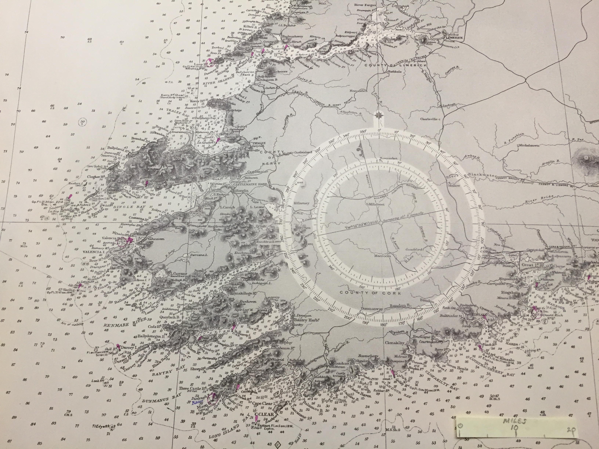
Cruising Grounds SW Ireland - West Cork & Kerry
Shannon Airport
Dingle Fourth stopover for Cruise in Company, Wednesday, July 22
Cork City & Airport
Cobh
Ancestral home of original Water Club of Cork, later Royal Cork YC.
Center of the parade of sail and salute to original clubhouse
Glengariff Third stopover for Cruise in Company, Sunday, July 19
Cork Harbor
Cruise Fest activities, July 7-11
Crosshaven
Royal Cork YC, marina and boatyard.
Center of festivities July 7-11.
Schull Second stopover for Cruise in Company, Thursday, July 16
Kinsale First stopover for Cruise in Company, Monday, July 13
50 40 30 20 10 0
MILES

